Slide 1
Search tree methods
CS340

Slide 2
Search Tree Methods, overall
How to solve hard combinatorial problems?
Exhaustive search (enumerating all candidate solutions and identifying the one with a desired property) takes too long
Construct a state-space tree
Construct partial candidate solutions one step at a time
If a candidate cannot possibly lead to a complete solution, stop and try something else

Slide 3
Backtracking
Use when there's no good way of ranking partial solutions
Construct partial solutions one component at a time
While a component can be added without violating the problem's constraints, keep adding
If the addition of a component violates the problem's constraints, backtrack. Remove the violating component and try a different component.

Slide 4
Backtracking
State Space Tree
Keeps track of choices made in an organized way
Promising
A node is promising if it represents a partial solution that may lead to a complete solution.
Nonpromising
A partial solution that will never lead to a complete solution.
Backtrack on nonpromising nodes.

Slide 5
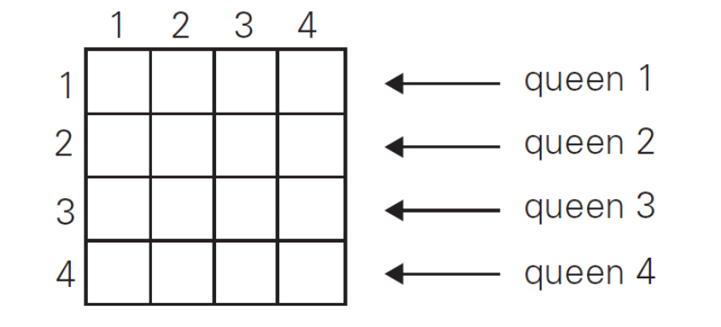
N-Queens
Place n queens on a nxn chessboard such that no queen is able to attack any other (up-down, left-right, diagonally).
One queen must be placed in each row…
The question is which column to put it in

Slide 6
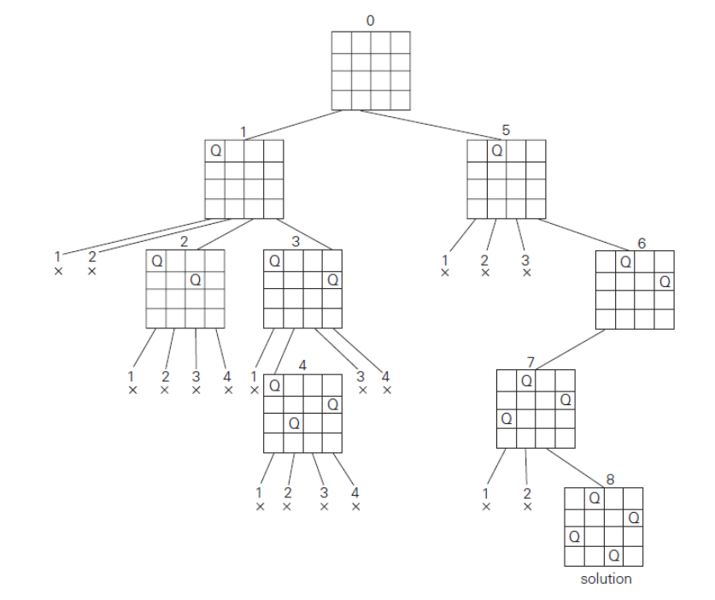
N-Queens

Slide 7
Interview Questions
What are benefits/drawbacks of the following representations of the n-queens solution space?
Boolean 2D array representing a board, true = occupied
Numbers 1 to n², representing spaces on board eg [1,6,9,13]
Integer coordinates for both axes [(0,1)(2,4)(3,3)(4,2)]
Integer coordinates for only the row [1,4,3,2]

Slide 8
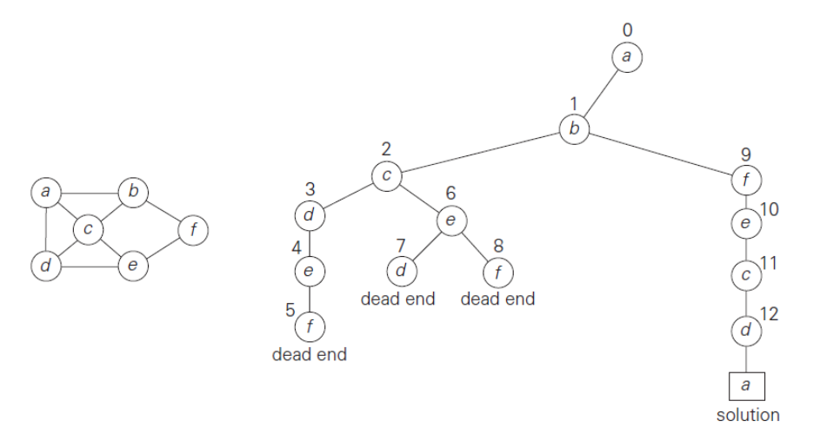
Hamiltonian Circuit

Slide 9
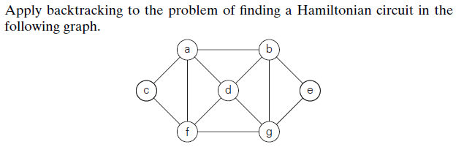
Interview Questions

Slide 10

Subset Sum
w_{i} = {3, 5, 6, 7}
W = 15

Slide 11
Backtracking
What kind of search are we doing?
What is the worst possible case?
Tricks to reduce the state space
Symmetry (think of n-queens)
Pre-assign values (Hamiltonian Circuit always starts at node a)
Sort the input (Subset sum input in ascending order)

Slide 12
Branch and Bound
Used for optimization problems
Trying to find the optimal solution (as opposed to feasible solutions)
Requires 2 more pieces of data
A way to provide a bound on the best value that can be obtained by continuing with the current partial solution (= a way to rank partial solutions)
The value of the best solution seen so far
Best-first
Instead of trying options in order, try the most promising ones first

Slide 13
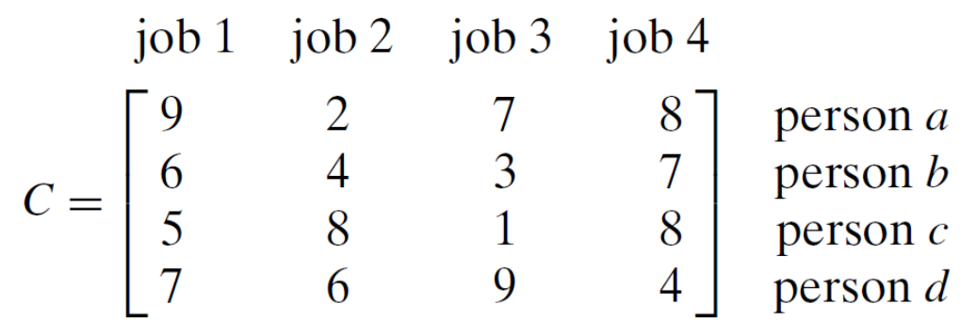
Assignment Problem
Assign n jobs to n people such that the total cost is as low as possible
What is a lower bound on the cost?

Slide 14

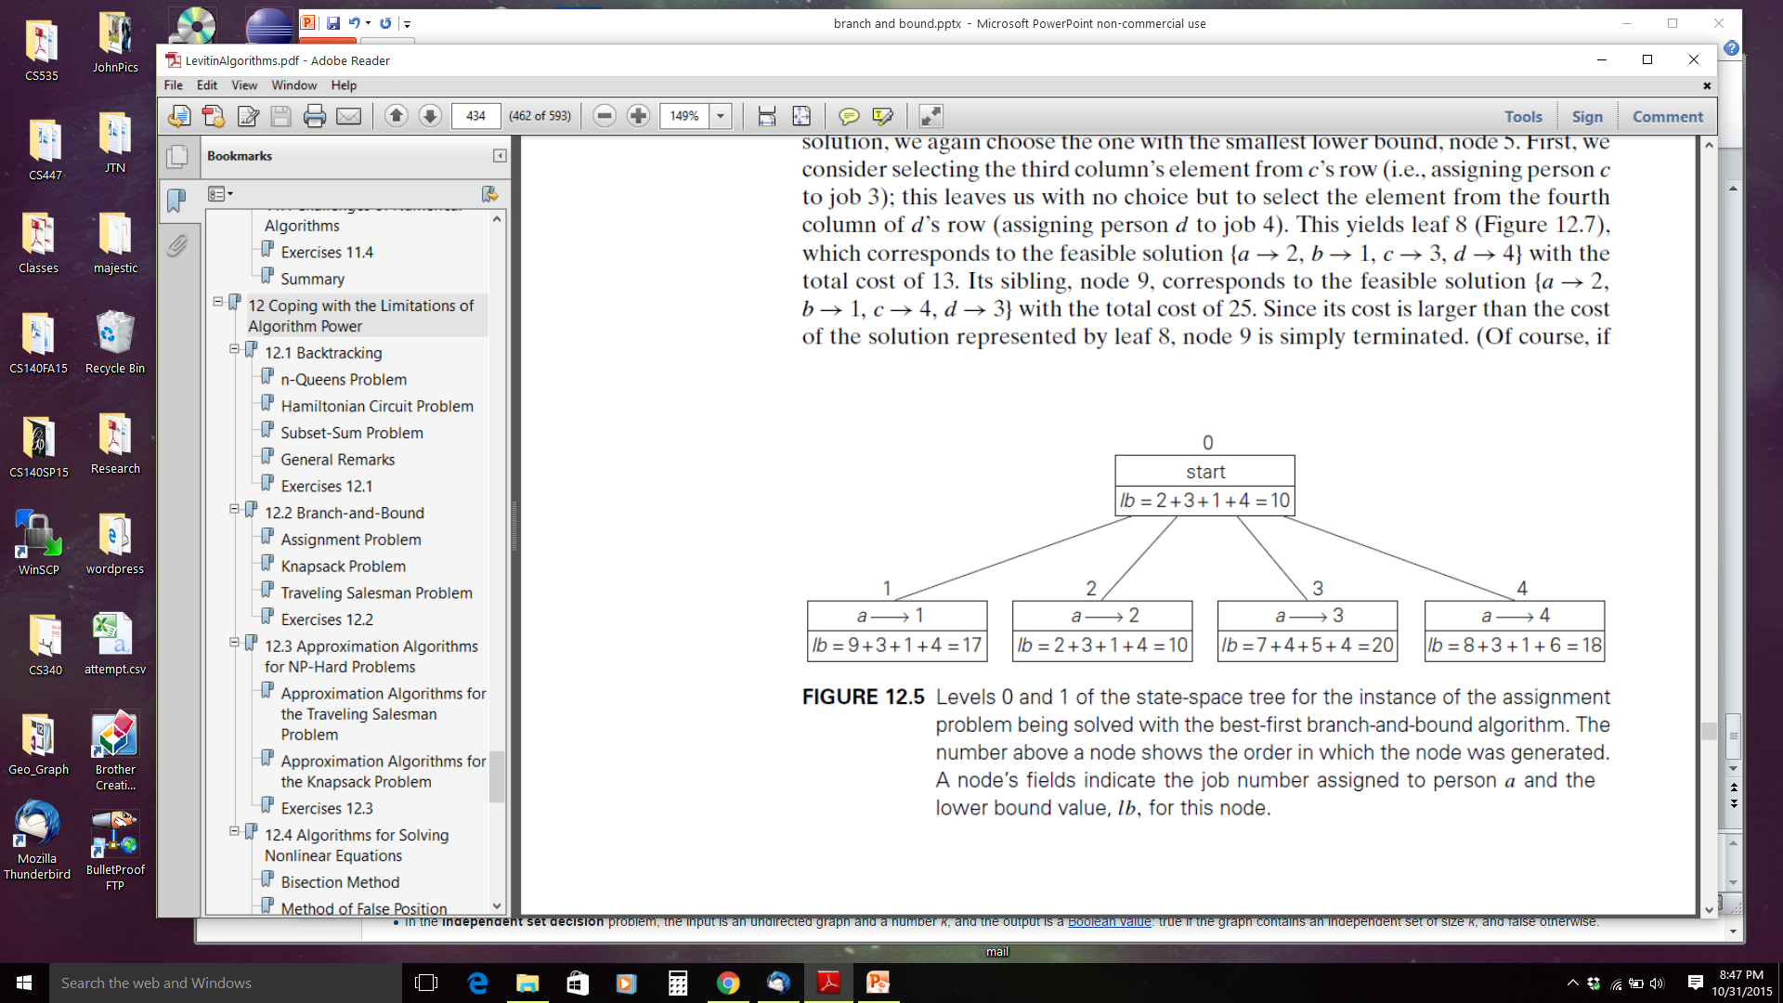
Assignment Problem
Most promising

Slide 15
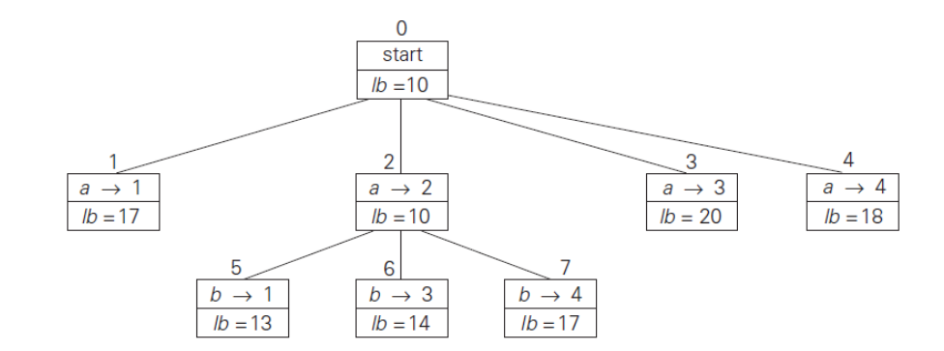
Assignment Problem

Slide 16
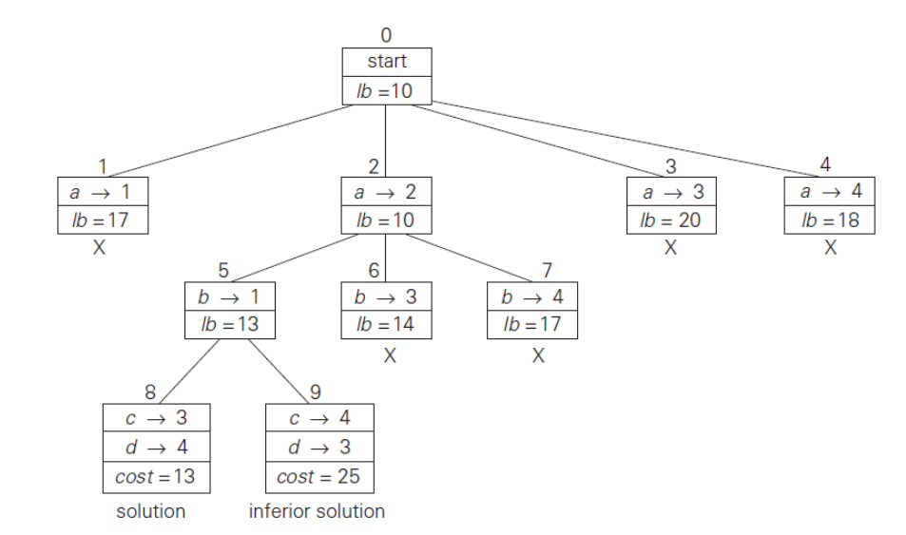
Assignment Problem

Slide 17
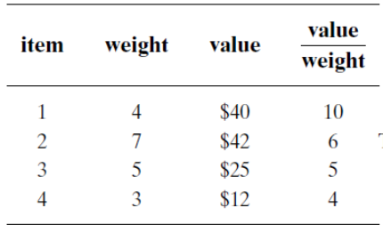
Knapsack
Order items by weight-to-value ratio (descending)
Upper bound =
current items + (remaining capacity * best payoff among remaining items)
Every node is a potential solution, therefore, evaluate best solution seen so far at each node, instead of at each leaf
Capacity W = 10

Slide 18
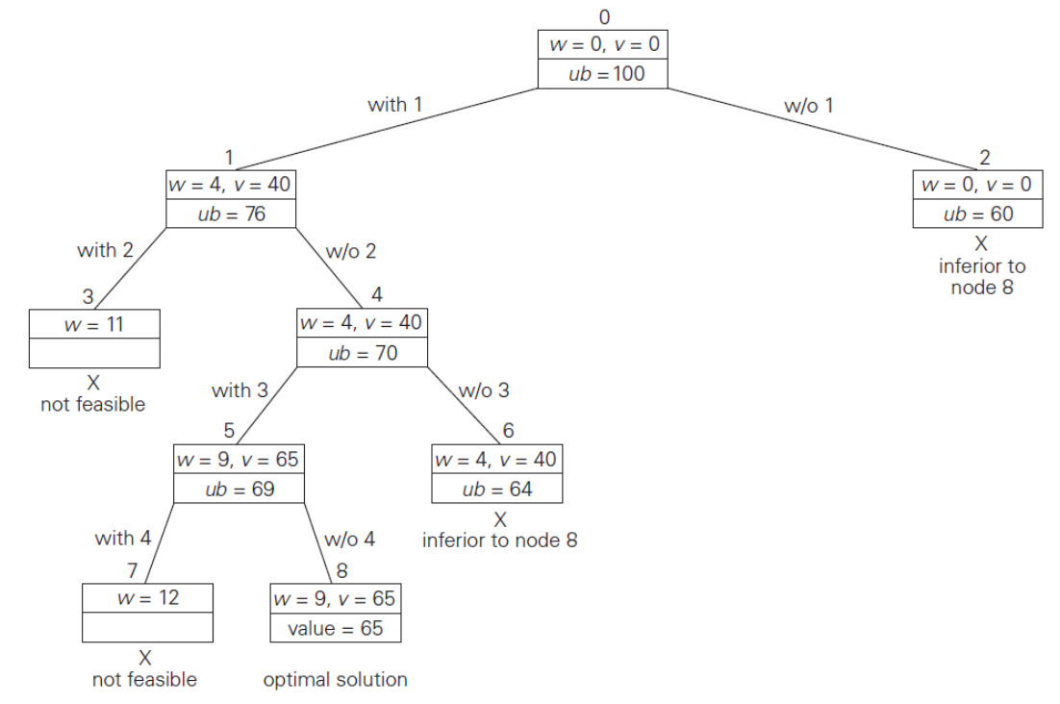
Knapsack
=40 + 6 * 6
=40 + 6 * 5
65 + 1 * 4 =
=40 + 6 * 4
Capacity W = 10

Slide 19
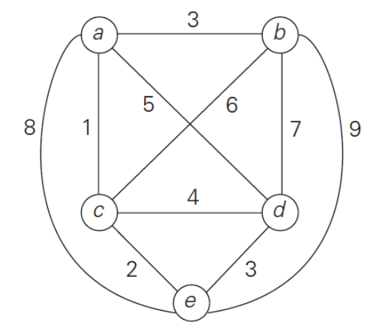
Traveling Salesman
One way to compute lower bound:
shortest distance * |V| = 5 (not so helpful)
A clever way to compute lower bound:
for each city, i, find the sum s_{i} of the distances to the two nearest cities
compute the sum, s, of these n numbers
divide by 2, and round up to nearest integer
Why does this work?
For this example,
lower bound = [(1+ 3) + (3 + 6) + (1+ 2) + (3 + 4) + (2 + 3)]/2 = 14

Slide 20
Traveling Salesman
A few more observations
A tour starts where it ends, therefore any starting point will work
We only need to consider tours starting at vertex A
The direction of the tour doesn't matter.
We only need to consider tours going in one direction
We will only consider tours where b is visited before c
After visiting n-1 cities, the only choice is to visit the last and return home

Slide 21
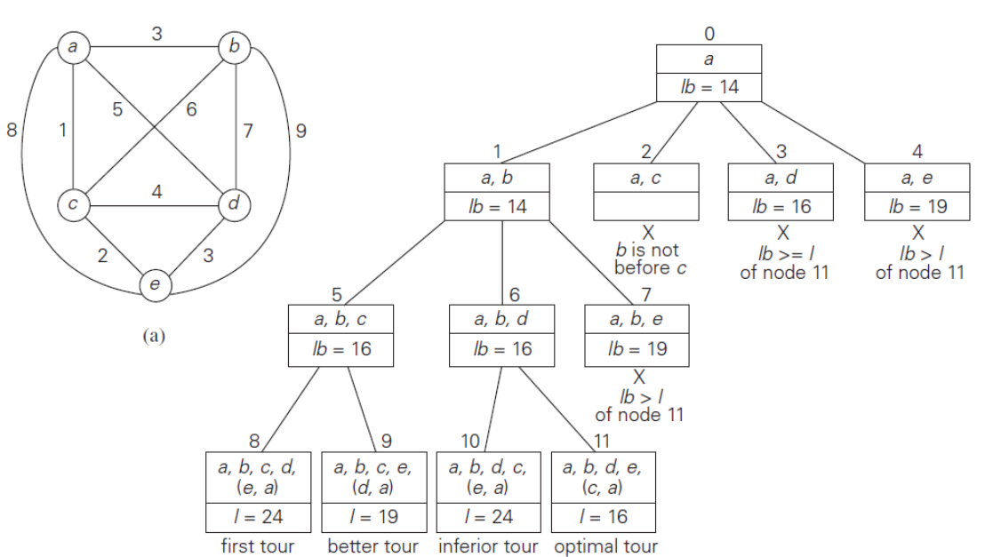
Traveling Salesman
ABC LB = [(1+ 3) + (3 + 6) + (6 + 1) +
(3 + 4) + (2 + 3)]/2 = 16
ABD LB = [(1+ 3) + (3 + 7) + (1 + 2) +
(3 + 7) + (2 + 3)]/2 = 16
ABE LB = [(1+ 3) + (3 + 9) + (1 + 2) +
(3 + 4) + (2 + 9)]/2 = 19

Slide 22
Branch and Bound
The hope is that we can do a lot of pruning
It's impossible to know in advance
What's the worst case?
Why would the worst case be achieved?
Challenges and opportunities
Finding a good bounding function
Choosing the order of node generation

Slide 23
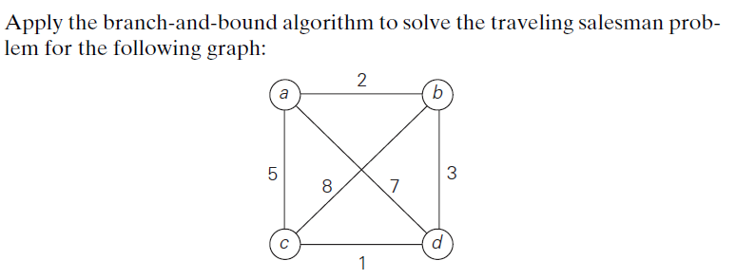
Interview Questions
What data structure would you use to keep track of live nodes in a best-first branch-and-bound algorithm?

